Slide 1

Insurance
By: Audrey Rahimi

Slide 2
What is the problem that you tried to solve
This dataset represents the activity of large number of customers who are interested in buying policies for home insurance. Each QuoteNumber corresponds to a potential customer and the QuoteConversion_Flag indicates whether the customer purchased a policy.
The provided features are anonymized they include specific coverage information, sales information, personal information, property information, and geographic information. The machine learning model is built to predict QuoteConversion_Flag for each QuoteNumber.
The Flag = 1 if the customer will buy the quote and Flag = 0 if not buy)

Slide 3
How did you solve it: the data you have, the model you built, maybe the feature engineering and/or data cleaning
Data preprocessing and Cleaning
QuoteNumber Original_Quote_Date QuoteConversion_Flag Field6 Field7 GeographicField61B GeographicField62A GeographicField62B GeographicField63 GeographicField64 Length: 299, dtype | int64 object int64 int64 int64 int64 int64 object object object
1. There is a huge data set which consists of: 260753, 299 rows and columns, which comes to (260753, 269) after data cleaning/engineering .
2. To analyse the data set, it is needed to know the type of data frame in details. It is combination of object and integer. To apply the data through the models, it is needed to convert columns which I chose as my features to int or float. 3. To have a good result, I applied 3 different models like: Perceptron, RandomForestClassifier and Lightgbm and compare the result to see which provide the better result.

Slide 4
Data cleaning
New Data Type
QuoteNumber QuoteConversion_Flag Field7 Field8 Field9 GeographicField60B GeographicField61A GeographicField61B GeographicField62A GeographicField62B | int64 int64 int64 float64 float64 int64 int64 int64 int64 int64
Columns should be converted from the object string to integer or float type to be able to apply the models which I chose.
At the final, the homogenous data type as follow which makes the features and target be ready to be chose got prepared.
There were not many missing data in my features which I dealt with.

Slide 5
Missing data: print(df.isnull().sum())
QuoteNumber 0 QuoteConversion_Flag 0 Field7 0 Field8 0 Field9 0 .. GeographicField60B 0 GeographicField61A 0 GeographicField61B 0 GeographicField62A 0 GeographicField62B 0 Length: 269, dtype: int64

Slide 6
Model training Train a linear model using Perceptron
Model Training features=df.drop('QuoteConversion_Flag',axis=1)
target=df['QuoteConversion_Flag']
X = features
y = target X_train,X_valid, y_train,y_valid = train_test_split(X,y,shuffle=True,random_state=10, test_size=0.1) Train a linear model using Perceptron model_pc = Perceptron(tol=1e-4, random_state=42,penalty='l2') # initialize perceptron model
model_pc.fit(X_train,y_train) # train model (learning)
y_pred_pc = model_pc.predict(X_valid)

Slide 7
Confusion matrix/f1_ascore of Perceptron
confusion_matrix(y_valid,y_pred_pc) f1_score(y_valid,y_pred_pc) print(classification_report(y_valid,y_pred_pc))
15186 6134
3410 1346
 | precision | recall | f1-score | Support
0 | 0.82 | 0.71 | 0.76 | 21320
1 | 0.18 | 0.28 | 0.22 | 4756
accuracy |  |  | 0.63 | 26076
macro avg | 0.50 | 0.50 | 0.49 | 26079
weighted avg | 0.70 | 0.63 | 0.66 | 26076

Slide 8

RandomForestClassifier
Random forest is a flexible, easy to use machine learning algorithm that produces, even without hyper-parameter tuning, a great result most of the time. It is also one of the most used algorithms, because of its simplicity and diversity.
model_rf = RandomForestClassifier(n_estimators=500,criterion='entropy',random_state=10,n_jobs=-1,max_depth=10,verbose=1)
n_estimators: Number of trees in forest n_jobs=-1 means that the computation will be dispatched on all the CPUs of the computer. max_depth, default=None, The maximum depth of the tree. If None, then nodes are expanded until all leaves are pure or until all leaves contain less than min_samples_split samples. erboseint, default=0. Verbose: Controls the verbosity when fitting and predicting.

Slide 9
[Parallel(n_jobs=-1)]: Using backend ThreadingBackend with 4 concurrent workers. [Parallel(n_jobs=-1)]: Done 42 tasks | elapsed: 37.0s [Parallel(n_jobs=-1)]: Done 192 tasks | elapsed: 2.8min [Parallel(n_jobs=-1)]: Done 442 tasks | elapsed: 6.4min [Parallel(n_jobs=-1)]: Done 500 out of 500 | elapsed: 7.2min finished [Parallel(n_jobs=4)]: Using backend ThreadingBackend with 4 concurrent workers. [Parallel(n_jobs=4)]: Done 42 tasks | elapsed: 0.0s [Parallel(n_jobs=4)]: Done 192 tasks | elapsed: 0.5s [Parallel(n_jobs=4)]: Done 442 tasks | elapsed: 1.2s [Parallel(n_jobs=4)]: Done 500 out of 500 | elapsed: 1.4s finished [Parallel(n_jobs=4)]: Using backend ThreadingBackend with 4 concurrent workers. [Parallel(n_jobs=4)]: Done 42 tasks | elapsed: 0.0s [Parallel(n_jobs=4)]: Done 192 tasks | elapsed: 0.4s [Parallel(n_jobs=4)]: Done 442 tasks | elapsed: 1.5s [Parallel(n_jobs=4)]: Done 500 out of 500 | elapsed: 1.7s finished [Parallel(n_jobs=4)]: Using backend ThreadingBackend with 4 concurrent workers. [Parallel(n_jobs=4)]: Done 42 tasks | elapsed: 0.1s [Parallel(n_jobs=4)]: Done 192 tasks | elapsed: 0.7s [Parallel(n_jobs=4)]: Done 442 tasks | elapsed: 1.7s [Parallel(n_jobs=4)]: Done 500 out of 500 | elapsed: 1.9s finished Confusion matrix; [20894 426] 3046 1710] f1_score:0.49622751015670347
Result RandomForestClassifier

Slide 10

Light Gradient Boosting Machine /lightgbm

Slide 11
Lightgbm
It is based on decision tree algorithms and used for ranking, classification and other machine learning tasks.
The LightGBM framework supports different algorithms including GBT, GBDT, GBRT, GBM, MART^{[6][7]} and RF.^{[8]} LightGBM has many of XGBoost's advantages, including sparse optimization, parallel training, multiple loss functions, regularization, bagging, and early stopping. A major difference between the two lies in the construction of trees. LightGBM does not grow a tree level-wise — row by row — as most other implementations do.^{[9]} Instead it grows trees leaf-wise. It chooses the leaf it believes will yield the largest decrease in loss.^{[10]} Besides, LightGBM does not use the widely-used sorted-based decision tree learning algorithm, which searches the best split point on sorted feature values,^{[11]} as XGBoost or other implementations do. Instead, LightGBM implements a highly optimized histogram-based decision tree learning algorithm, which yields great advantages on both efficiency and memory consumption. ^{[12]} ^{Extracted from Wiki}

Slide 12
Train in 1th and 2th fold

Slide 13
Train in 3th and 4th fold

Slide 14
Train in 5th fold

Slide 15
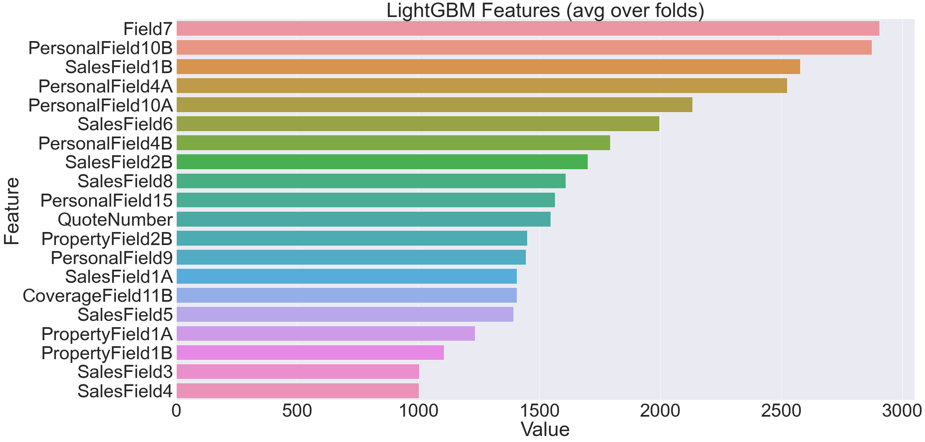
Feaure importance

Slide 16
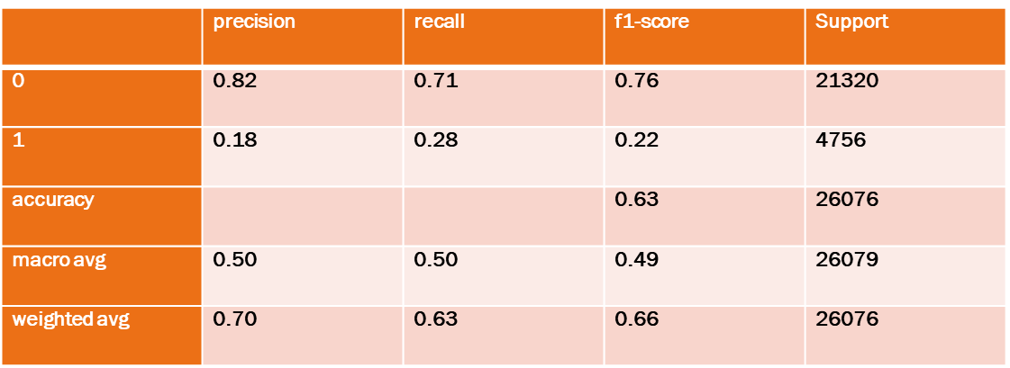
Result
Perceptron
RandomForestClassifier
f1_score:0.49622751015670347
Confusion Matrix:
20894 426
3046 1710
Light GBM
Confusion Matrix:
15186 6134
3410 1346
The average mean AUC is :
0.9514462255667813

Slide 17
The Results Obtained
By average mean of AUC = 0.951, based on lightgbm model running through 5 folds, the model behaves well. A good result by selecting the value of the threshold that gives TPR close to 1 while keeping FPR near 0. Also as confusion matrix of RandomForestClassifier shows that
Out of 26053 there are 20894 correctly classified as TP which means the model incorrectly classified 426. in this case there are 1710correctly calssified (1710 true negatives or TN=1710) and 3046=FP.
Also as confusion matrix of in Perceptron Out of 26053 there are 15186 correctly classified as TP which means the model incorrectly classified 6134. In this case there are 1346 correctly classified (1346 true negatives or TN=1346) and 3410=FP.
We got the idea that RandomForestClassifier provides better resul With 87% more efficiency compare to Perceptron which has 64%.
https://github.com/audreyrah2018/Models1151
20894 426
3046 1710
15186 6134
3410 1346

